Slide 1
PROPS & STATE
LIFECYCLE
By Mykhailo Torskyi

Slide 2
COMPONENT
Components are independent and reusable bits of code. They serve the same purpose as JavaScript functions, but work in isolation and returns HTML via a render function.

Slide 3
STATE
The state object is where you store property values that belongs to the component.
The state object can contain as many properties as you like
React components has a built-in state object.
When the state object changes, the component re-renders.

Slide 4
STATE USAGE
Refer to the state object anywhere in the component by using the this.state.propertyName syntax
To change a value in the state object, use the this.setState() method
When a value in the state object changes, the component will re-render

Slide 5

PROPS
Props are arguments passed into React components.
Props are passed to components via HTML attributes.
Props in constructor function should always be passed to the constructor and also to the React.Component via the super() method.
React Props are read-only! You will get an error if you try to change their value.

Slide 6
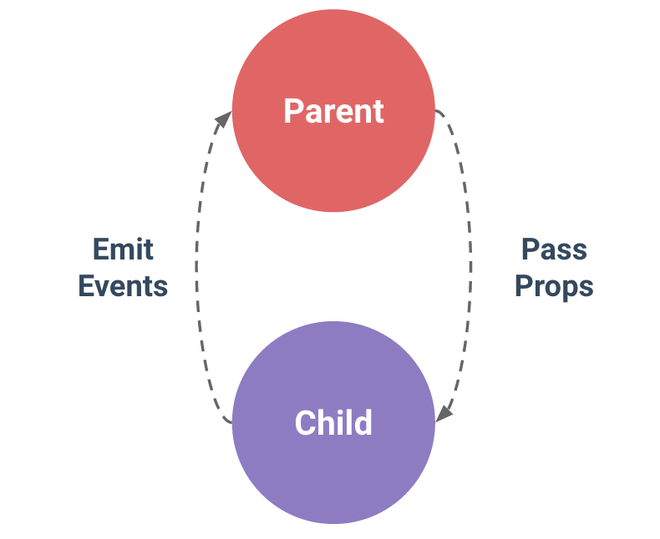
PROPS PASSING

Slide 7
REACT LIFECYCLE
Mounting
Updating
Unmounting.

Slide 8
MOUNTING
When mounting a component react will execute these four methods:
constructor()
getDerivedStateFromProps()
render()
componentDidMount()
The render() method is required and will always be called, the others are optional and will be called if you define them.

Slide 9
UPDATING
A component is updated whenever there is a change in the component's state or props
getDerivedStateFromProps()
shouldComponentUpdate()
render()
getSnapshotBeforeUpdate()
componentDidUpdate()

Slide 10
UNMOUNTING
Gets called When a component is removed from the DOM
componentWillUnmount()

Slide 11
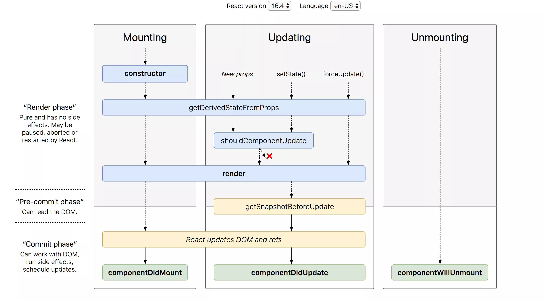

Slide 12


